Slide 1
Rails Girls Summer of Code
And our experiences!

Slide 2
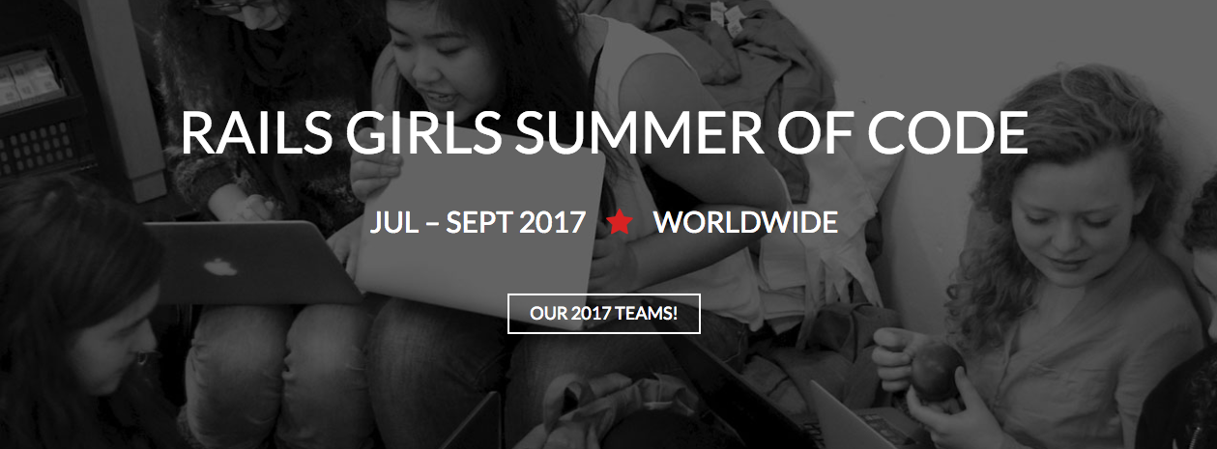
What is RGSoC?

Slide 3
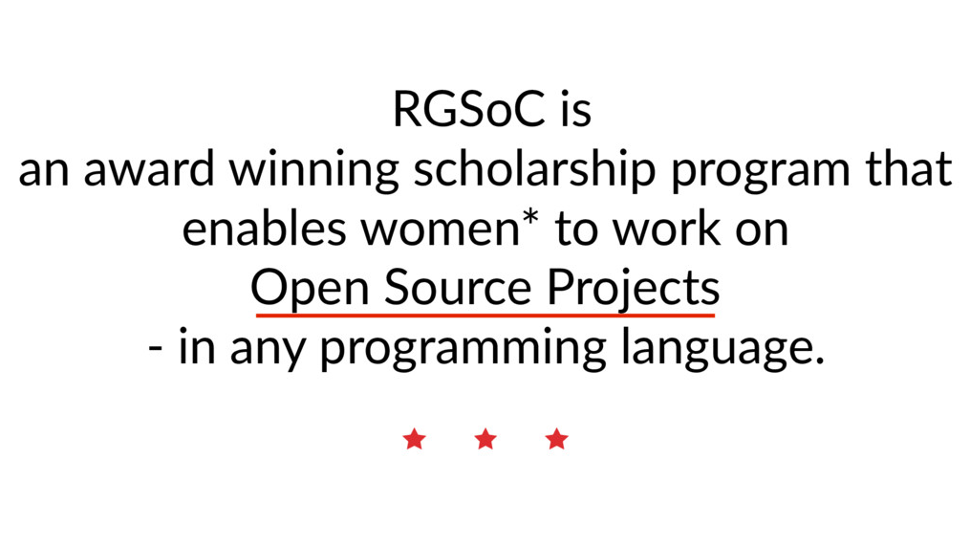

Slide 4
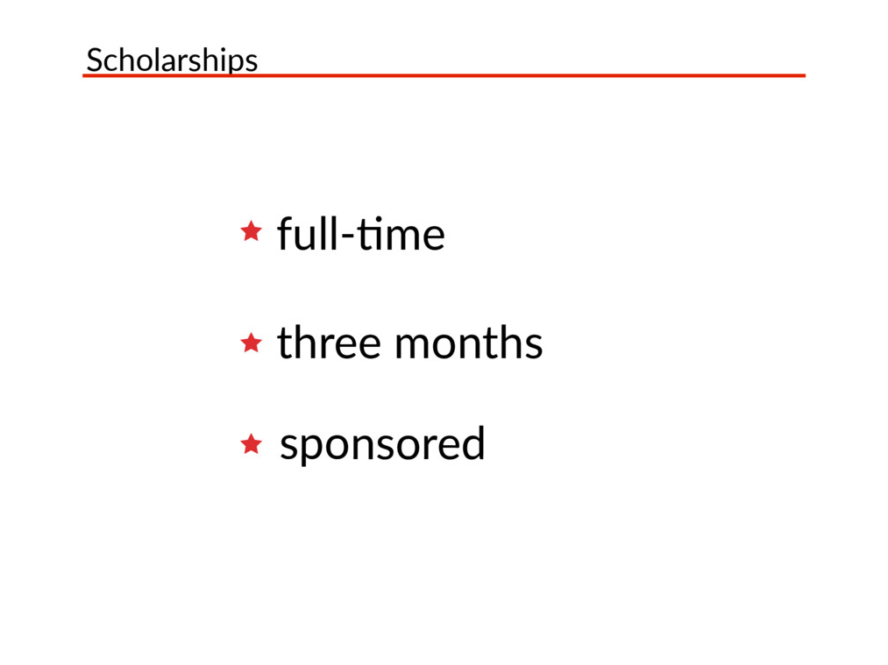

Slide 5
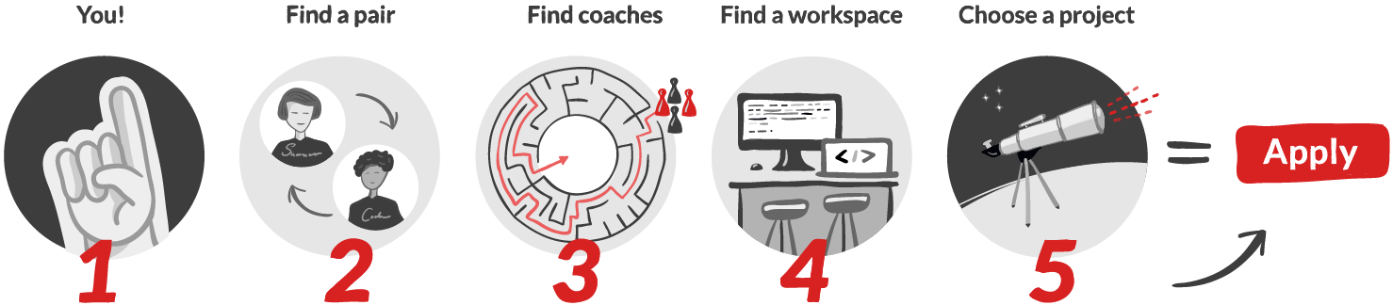
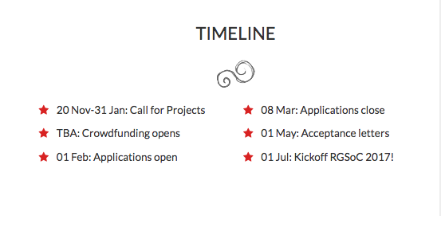

Slide 6
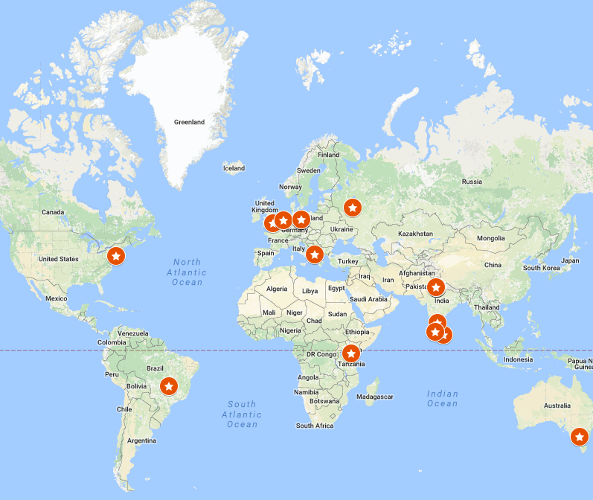
RGSoC 2017
190 Applications from around the WORLD!
21 Countries
16 Sponsored Teams
4 Volunteer Teams
4 Teams from Germany and 4 Teams from India are in the top ten!

Slide 7
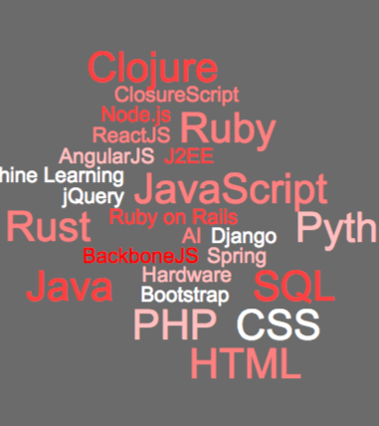
Projects - OPEN SOURCE!
Tessel
Coala
Diaspora *
Susi AI - FOSSASIA
Babel
Servo
The Processing Foundation
OpenFarm
Nextcloud
…….and so many more!

Slide 8
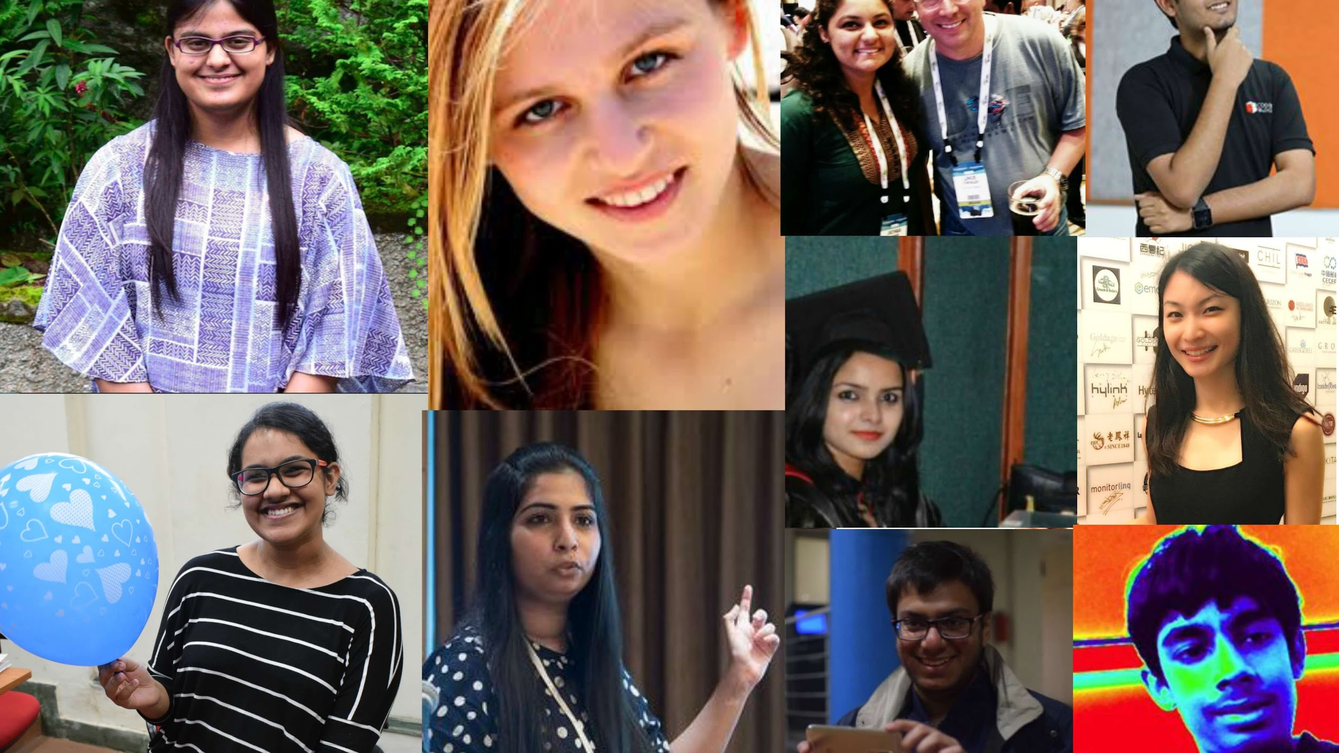
Team 276linesofCode

Slide 9
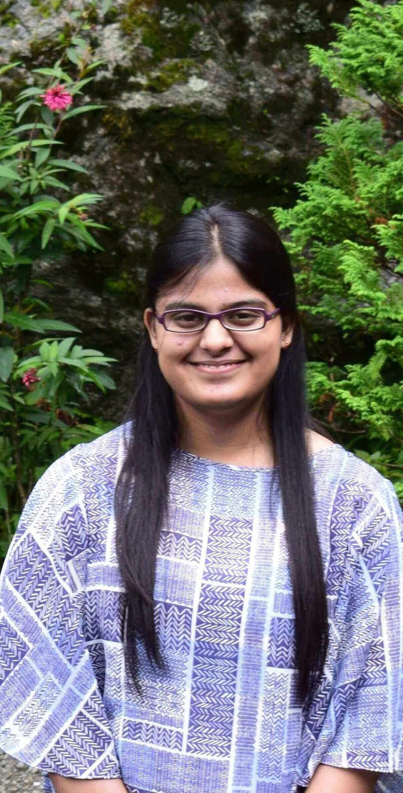
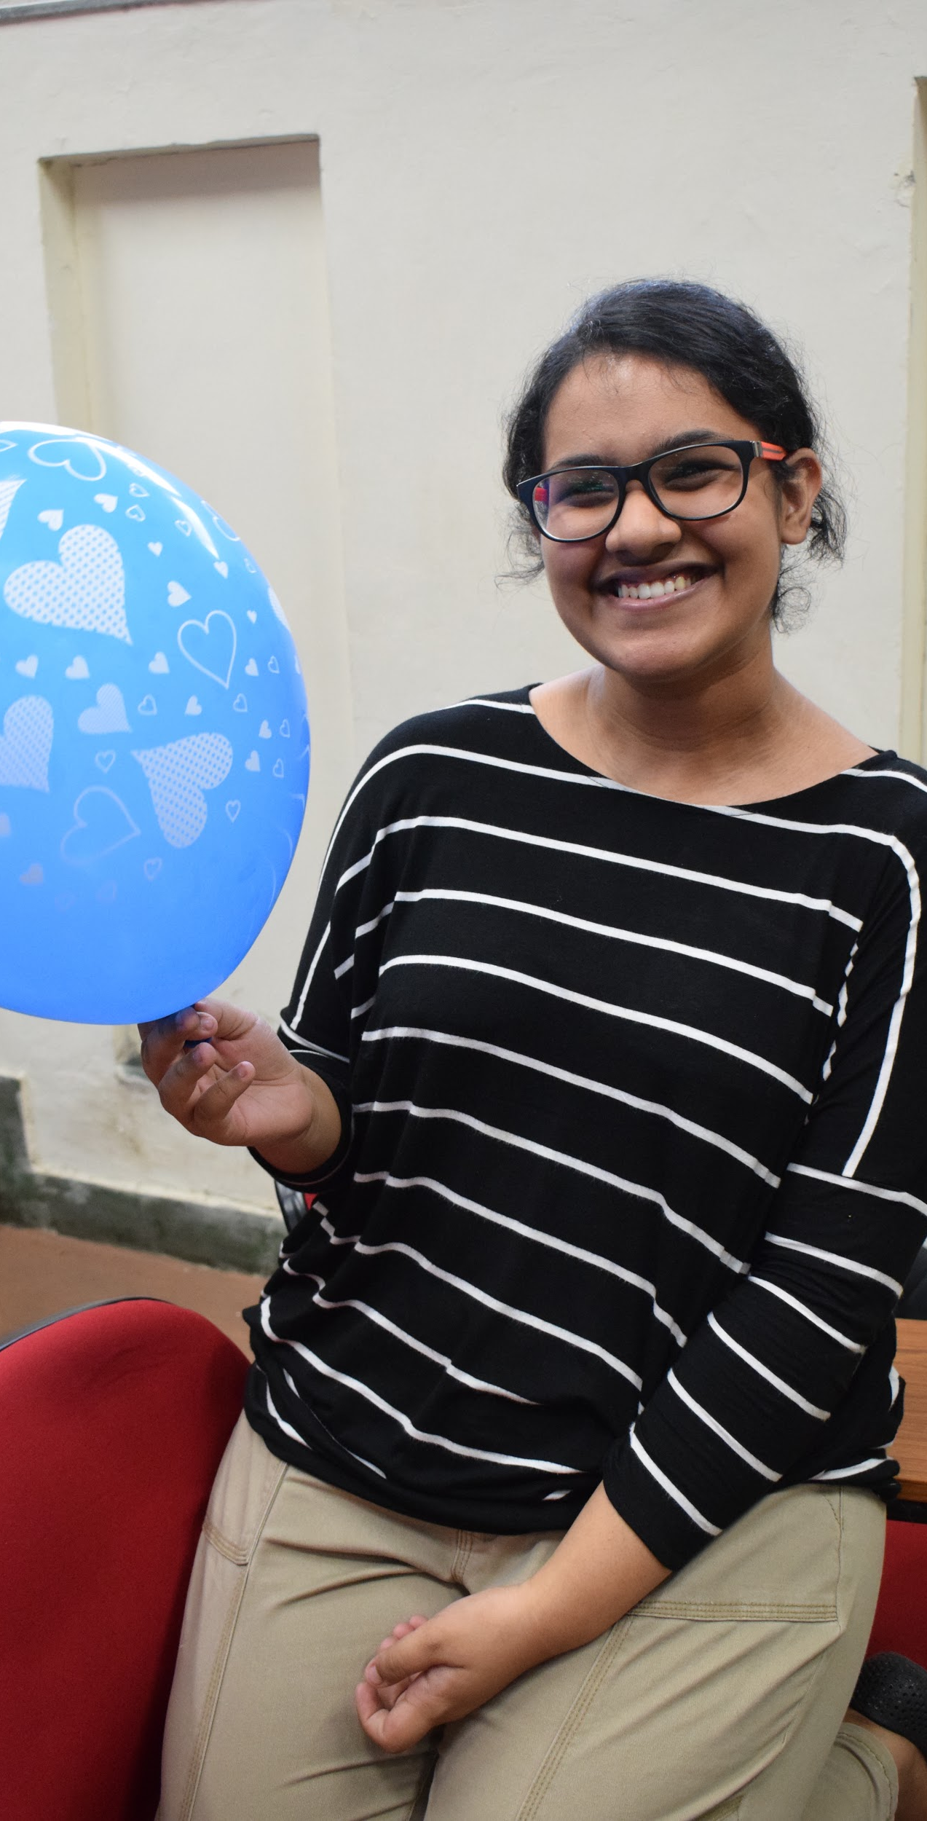
The Students

Slide 10
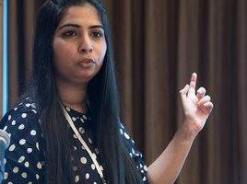
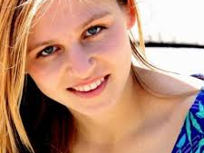
The Supervisor - Vaishali Thakkar
The Mentor - Kelsey Breseman

Slide 11
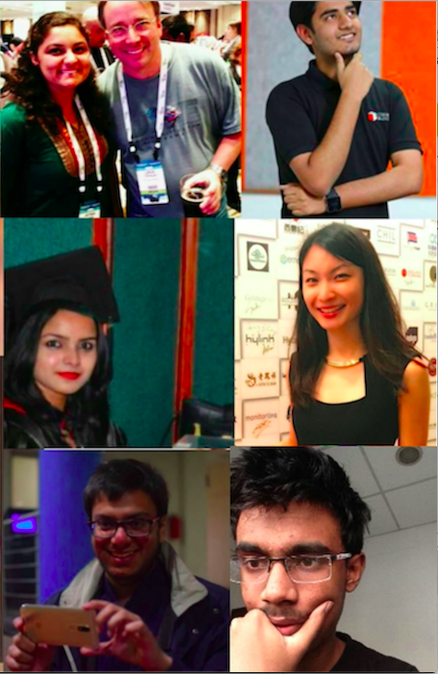
The Coaches
Jigyasa Grover
Umair Khan
Diksha Deo
Dana Liu
Sanchit Gupta
Divam Gupta

Slide 12
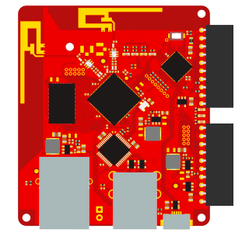
The Project -
Tessel

Slide 13
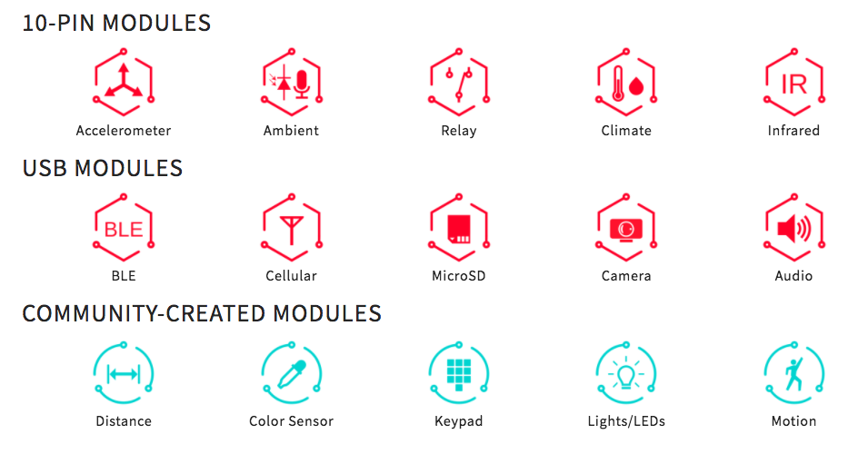
Functionalities and Modules

Slide 14
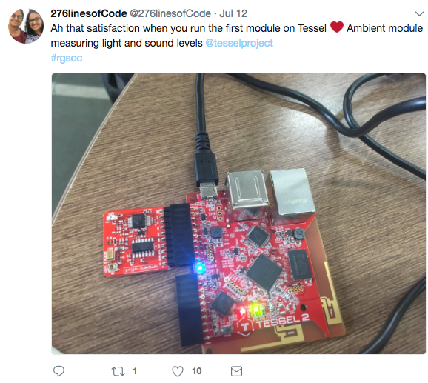
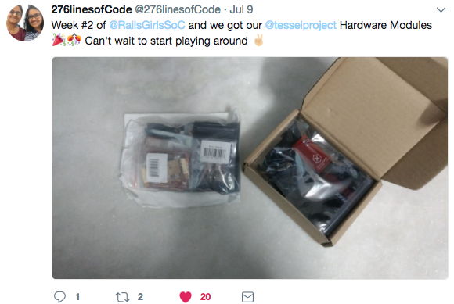
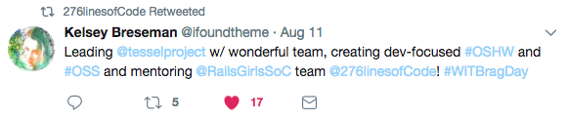
Stuff we’re working on..

Slide 15
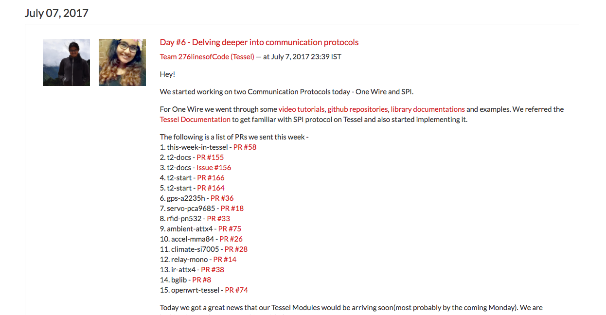
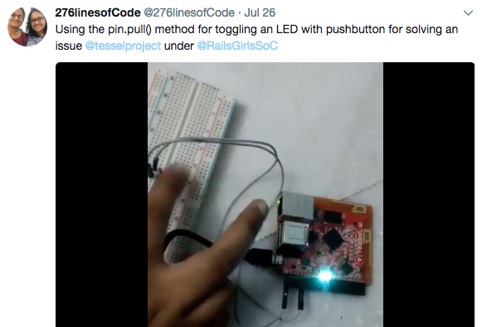
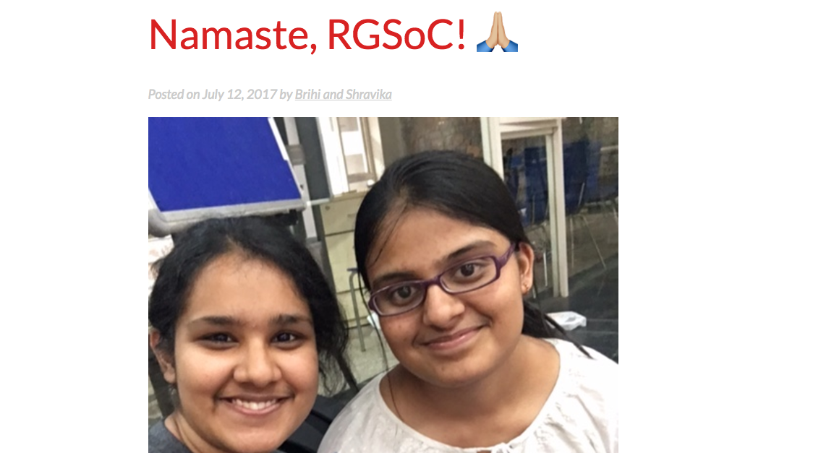
Stuff we’re working on..

Slide 16
Demos!
Notes:
LEDs
Pushbuttons
Accelerometer
Servo
Clap

